Slide 1
SC1015 Mini Project
Prediction on Severity of Road Accidents
ECAD 1 Group 8
Kevin Yok, Liv Tan Ker Jin, Ng Yong Jian

Slide 2
01
Sample Collection & Practical Motivation

Slide 3
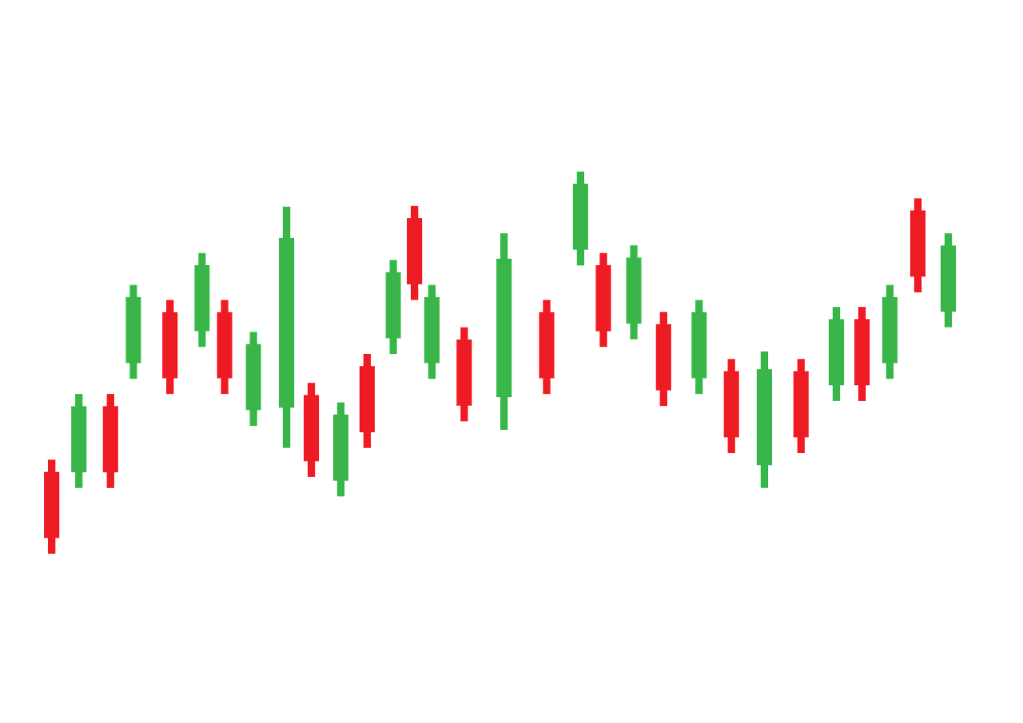
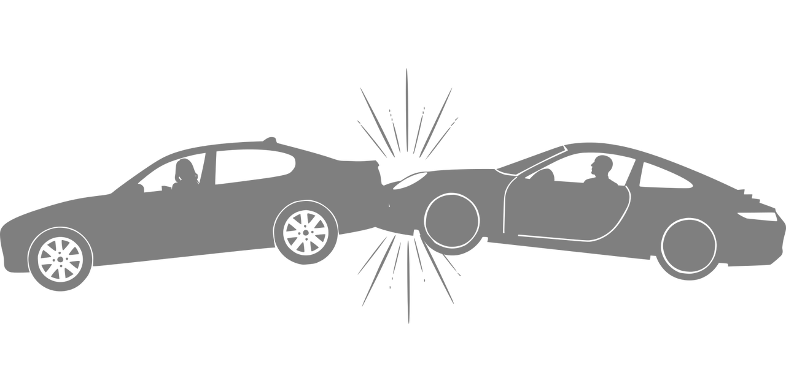
Road Accidents
in the United States
38,000 deaths
4.4m seriously injured

Slide 4
How do different factors affect severity of road accidents in the US?
Notes:
In order to reduce occurence of car accidents, we must first study the factors affecting it. This leads to our problem: How do different factors affect severity of road accidents in the US?

Slide 5
Data collected: US Accidents (2016-2021) By Sobhan Moosavi from Kaggle.com
https://www.kaggle.com/datasets/sobhanmoosavi/us-accidents
Notes:
In this project, we are exploring the US Accidents(2016-2021) dataset by Sobhan Moosavi found on Kaggle. The dataset can be found from this link. It records the conditions during the car accidents such as time, weather conditions, visibility, severity etc.

Slide 6
02
Data Preparation

Slide 7
The data set has 47 columns and 2.8m data
Distance and Severity as response variables
Extracting columns
Replace NULL inputs
Reduce unique categories under “WEATHER CONDITIONS”

Slide 8
Data Preparation: Extract 20 Columns
columns
columns
20
47

Slide 9
Data Preparation: Replace NULL Inputs
SimpleImputer
SimpleImputer
Fillna
TEMPERATURE
PRESSURE
DAY_NIGHT
HUMIDITY
WIND_SPEED
WEATHER_CONDITION
NaN → Mean
Skewness between -1 and 1
NaN → Median
Skewness less than-1 or greater than 1
NaN → NotDefined

Slide 10
Data Preparation: Weather Conditions
categories
categories
15
128

Slide 11
03
Exploratory Analysis & Analytic Visualization

Slide 12
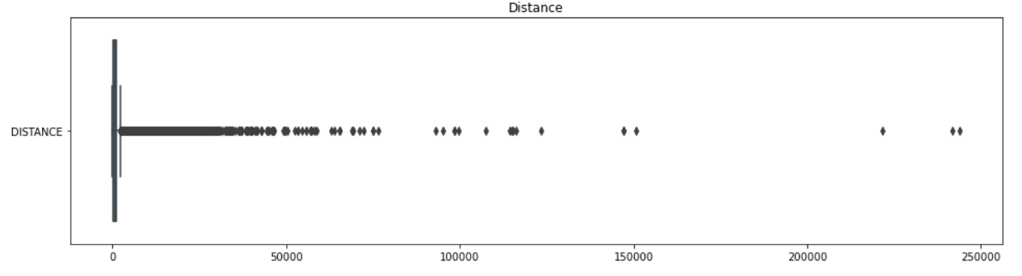
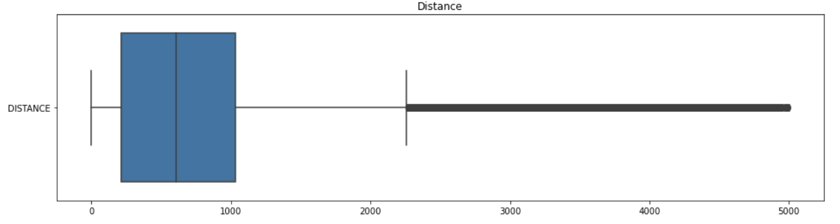
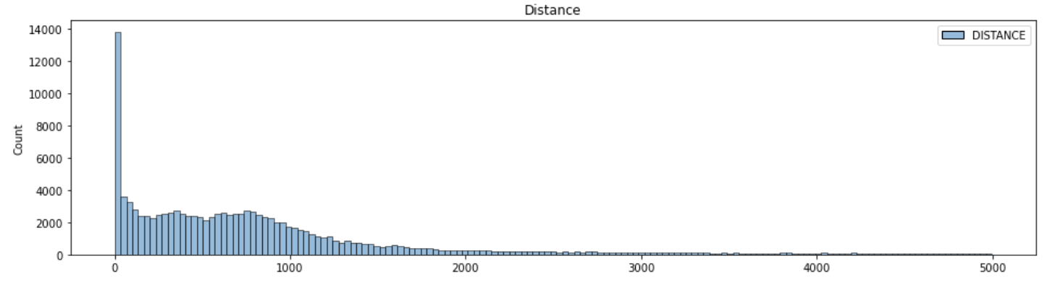
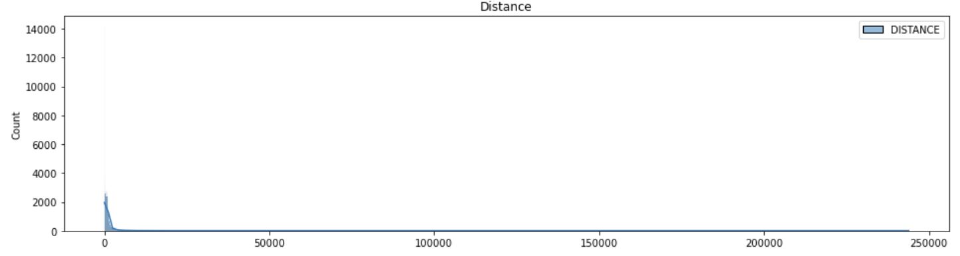
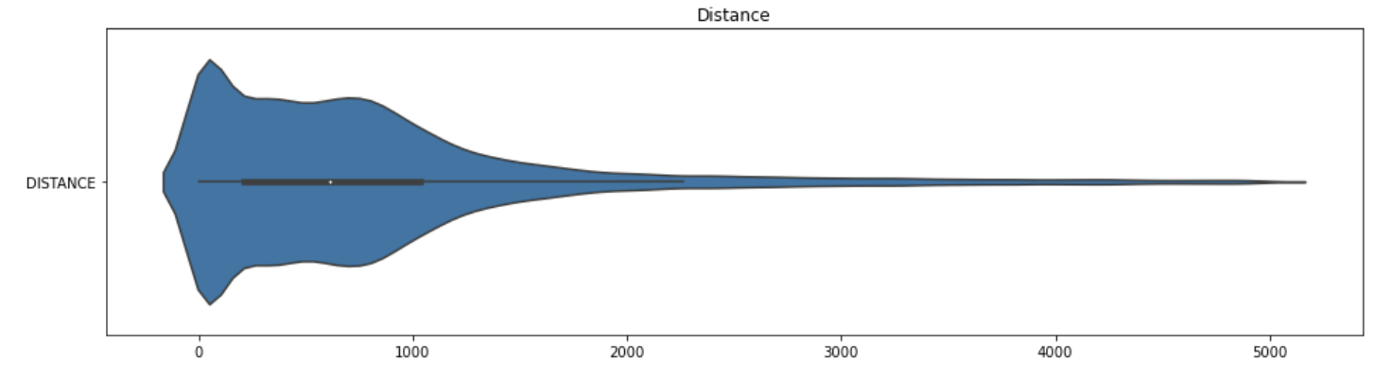
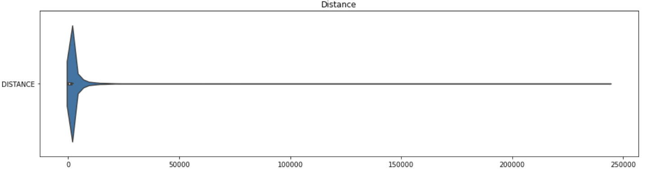
Response Variable: Distance

Slide 13
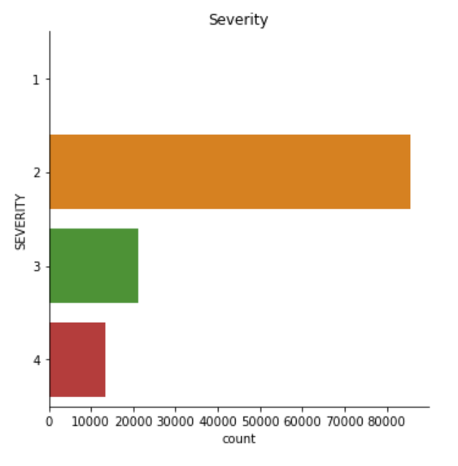
Response Variable: Severity
Severity | Count
1 | 0
2 | 85545
3 | 21118
4 | 13546

Slide 14
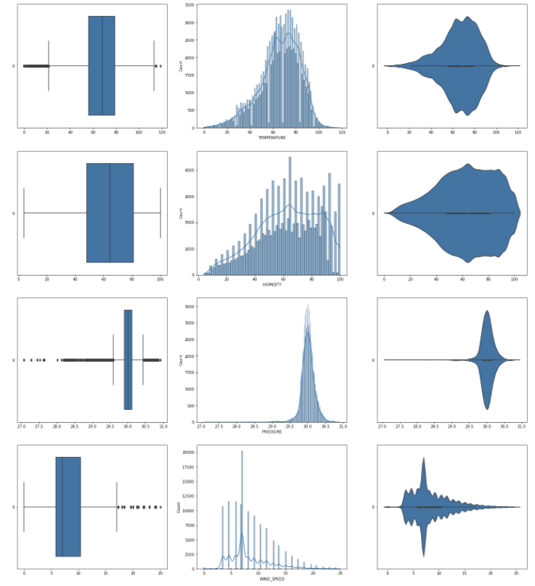
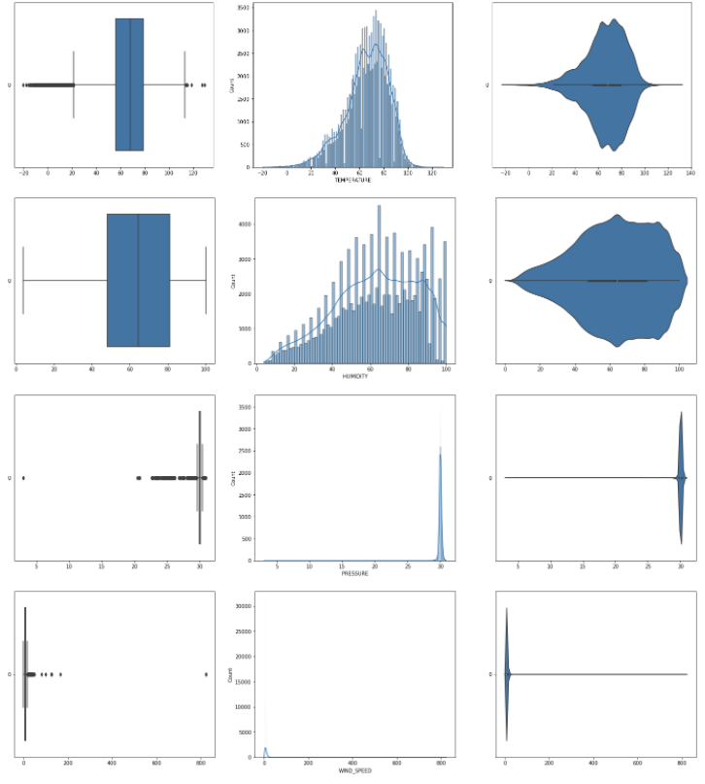
Numeric Predictors
Temperature
Humidity
Pressure
Wind Speed

Slide 15
Categorical Predictors
CROSSING
SIDE
TRAFFIC
SIGNAL
JUNCTION

Slide 16
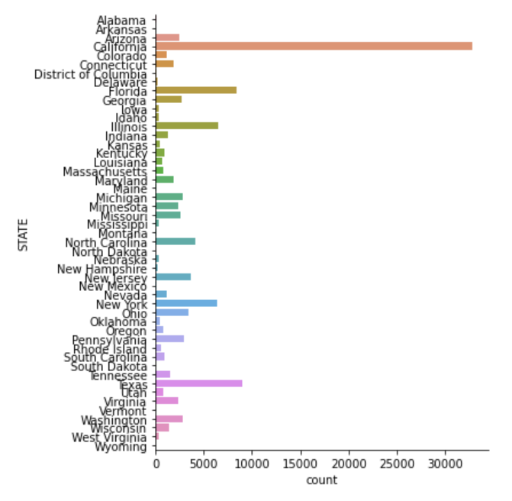
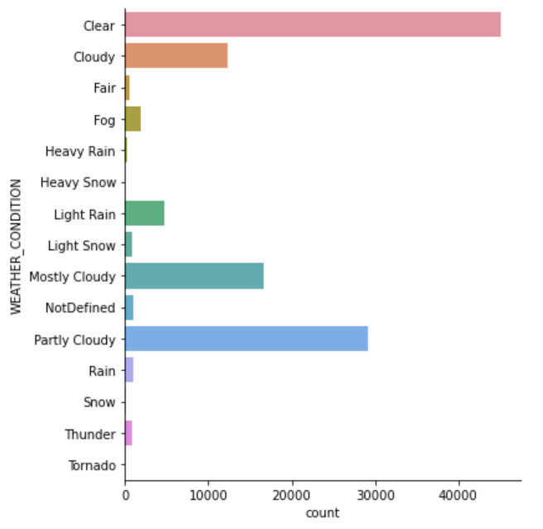
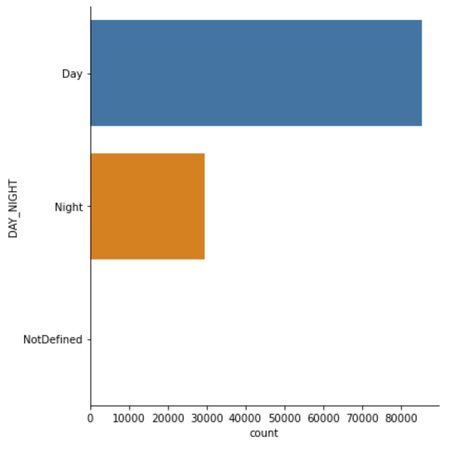
Categorical Predictors
State
Weather Condition
Day Night

Slide 17
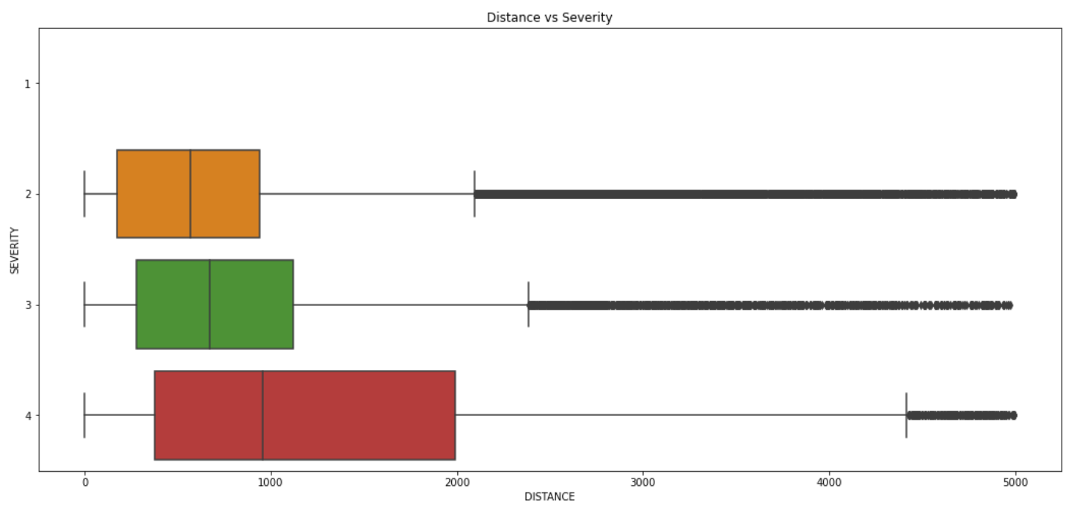
Severity vs Distance
_ _ _ _ _ _ _
_ _ _ _ _ _ _
_ _ __ _ _ _

Slide 18
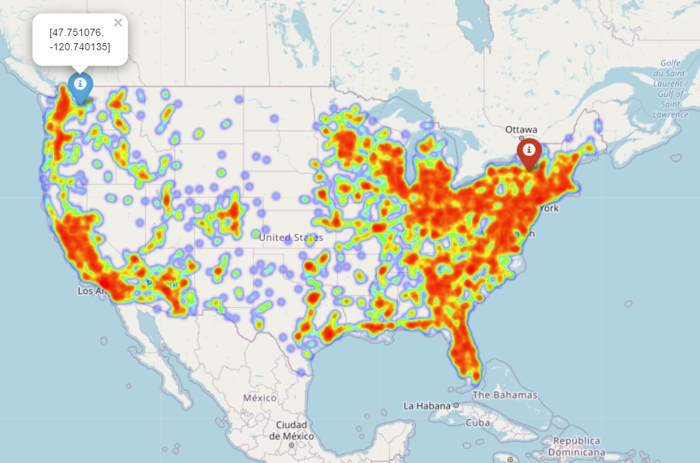
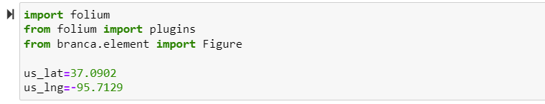
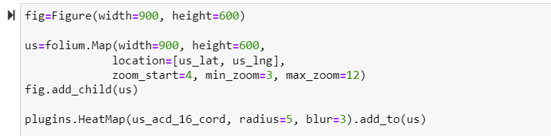
Geospatial Visualization
import folium
from folium import plugins
from branca.element import Figure
us_lat=37.0902
us_lng=-95.7129
fig=Figure(width=900, height=600)
us=folium.Map(width=900, height=600,
location=[us_lat, us_lng],
zoom_start=4, min_zoom=3, max_zoom=12)
fig.add_child(us)
plugins.HeatMap(us_acd_16_cord, radius=5, blur=3).add_to(us)

Slide 19
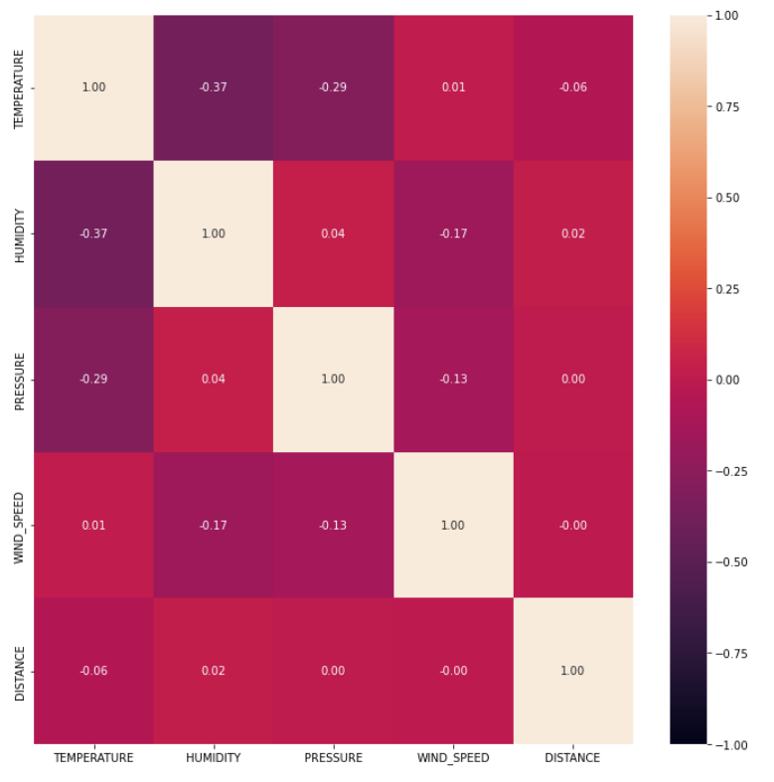
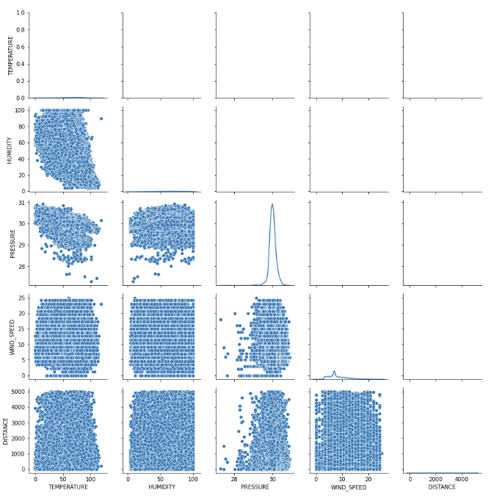
Correlation between Numeric Variables

Slide 20
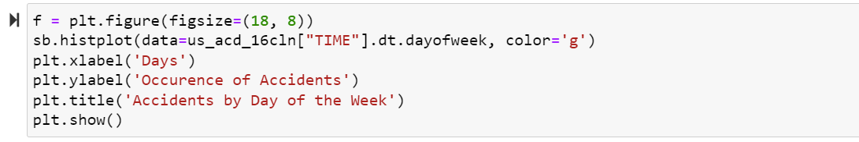
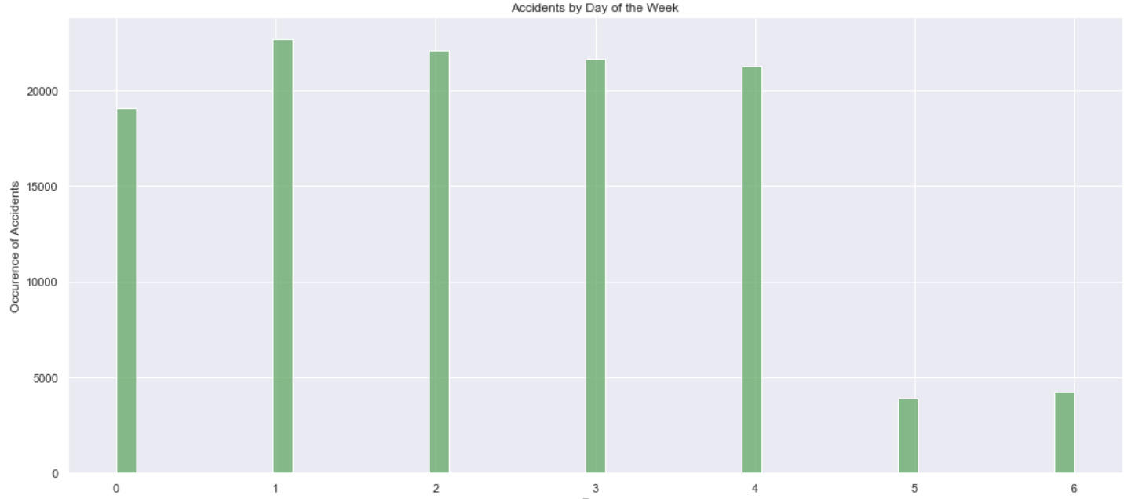
Time vs Accident
f = plt.figure(figsize=(18, 8))
sb.histplot(data=us_acd_16cln["TIME"].dt.dayofweek, color='g')
plt.xlabel('Days')
plt.ylabel('Occurence of Accidents')
plt.title('Accidents by Day of the Week')
plt.show()
Weekdays

Slide 21
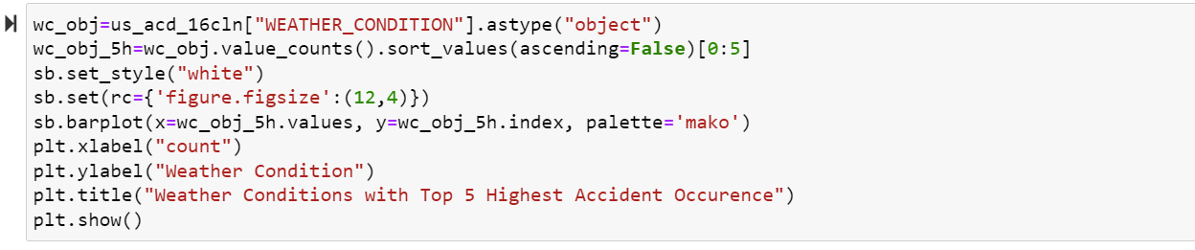
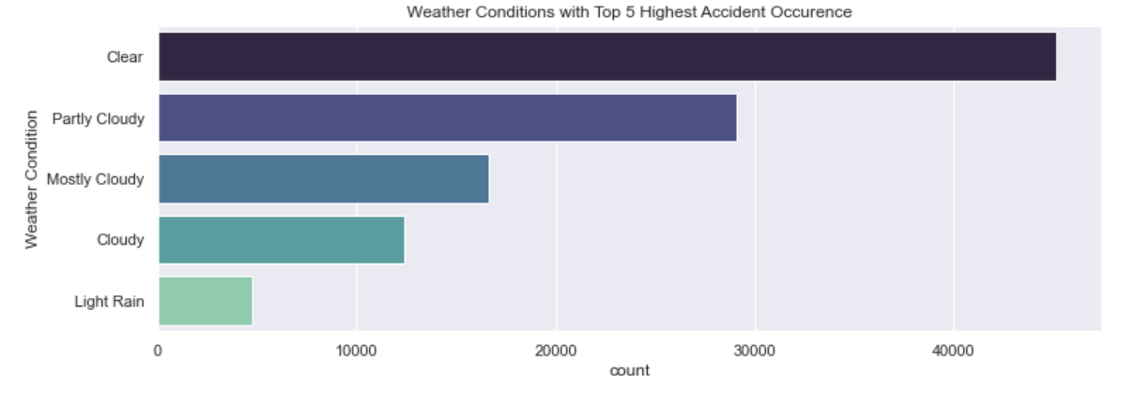
Weather Condition vs Accident
wc_obj=us_acd_16cln["WEATHER_CONDITION"].astype("object")
wc_obj_5h=wc_obj.value_counts().sort_values(ascending=False)[0:5]
sb.set_style("white")
sb.set(rc={'figure.figsize':(12,4)})
sb.barplot(x=wc_obj_5h.values, y=wc_obj_5h.index, palette='mako')
plt.xlabel("count")
plt.ylabel("Weather Condition")
plt.title("Weather Conditions with Top 5 Highest Accident Occurence")
plt.show()

Slide 22

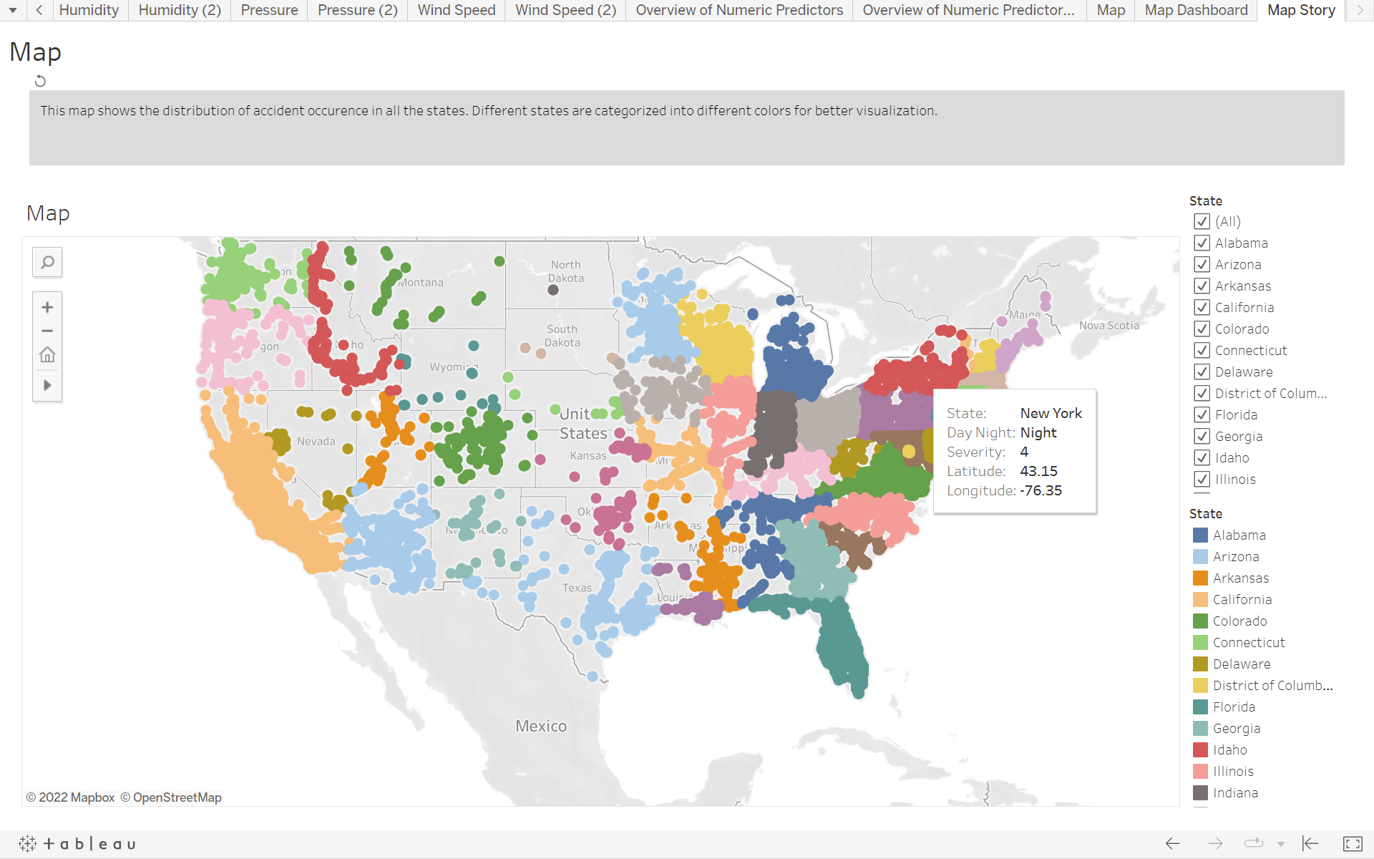
EDA via Tableau
Click here to explore the Tableau workbook.
Map Story
Overview of Response Variables Story
Overview of Numeric Predictors Story
Categorical Variables vs Severity Story
Follow the suggested order shown next for an insightful and interactive EDA experience.
Time vs Count Story

Slide 23
04
Machine Learning &
Statistical Inference

Slide 24
OLS LinearRegression
LinearRegression is a multivariate linear regression which fits a linear model with coefficients w = (w1, …, wp) to minimize the residual sum of squares between the observed targets in the dataset, and the targets predicted by the linear approximation.

Slide 25
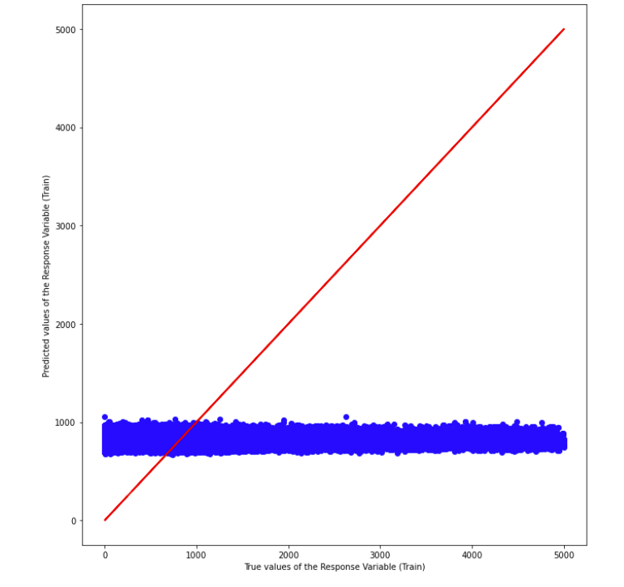
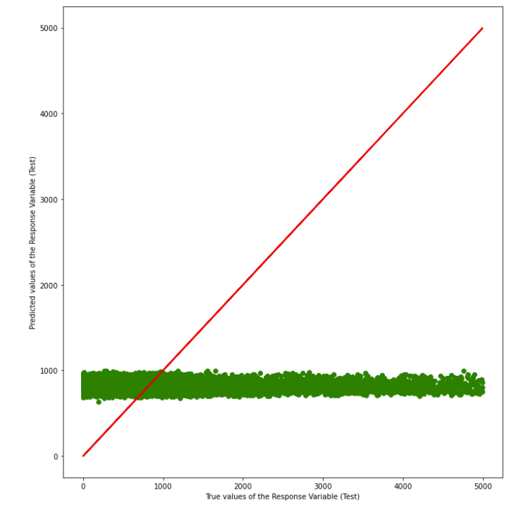
OLS Linear Regression (initial data)
Train Data
Test Data
R^2: 0.003486
MSE: 729430.7
R^2: 0.004399
MSE: 715424.5

Slide 26
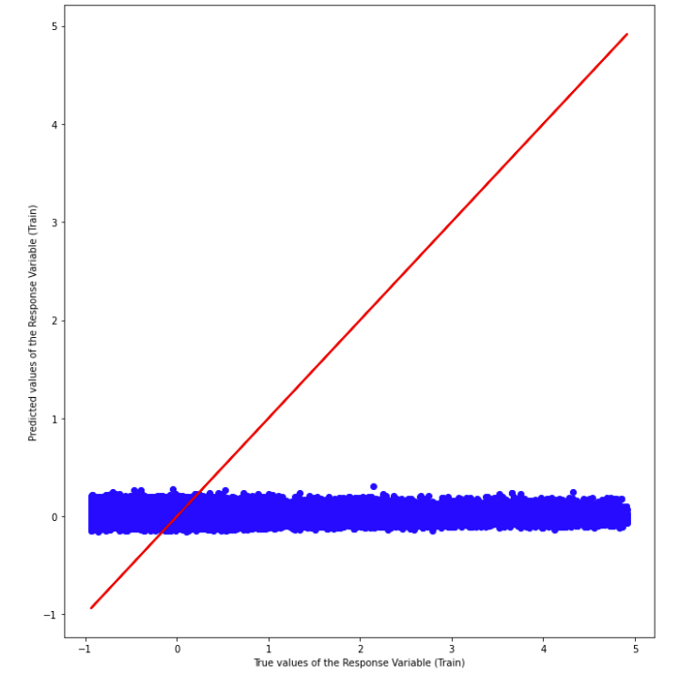
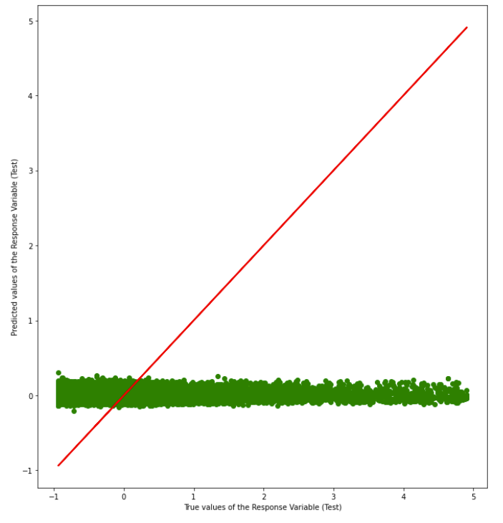
OLS Linear Regression (with StandardScalar)
Train Data
Test Data
R^2: 0.003672
MSE: 0.994736
R^2: 0.003619
MSE: 1.002714

Slide 27
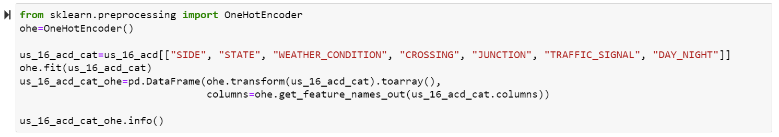
OneHotEncoder
This model encodes categorical features as a one-hot numeric array. In this strategy, each category value is converted into a new column and assigned a 1 or 0 (notation for true/false) value to the column.
from sklearn.preprocessing import OneHotEncoder
ohe=OneHotEncoder()
us_16_acd_cat=us_16_acd[["SIDE", "STATE", "WEATHER_CONDITION", "CROSSING", "JUNCTION", "TRAFFIC_SIGNAL", "DAY_NIGHT"]]
ohe.fit(us_16_acd_cat)
us_16_acd_cat_ohe=pd.DataFrame(ohe.transform(us_16_acd_cat).toarray(),
columns=ohe.get_feature_names_out(us_16_acd_cat.columns))
us_16_acd_cat_ohe.info()

Slide 28
DecisionTreeClassifier
Decision Tree is a Supervised Machine Learning Algorithm that uses a set of rules to make decisions, similarly to how humans make decisions.

Slide 29
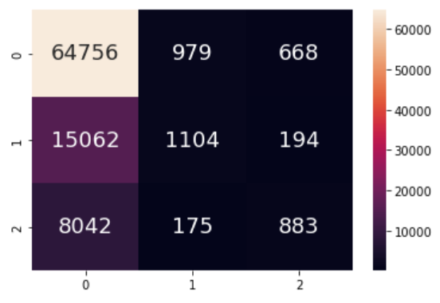
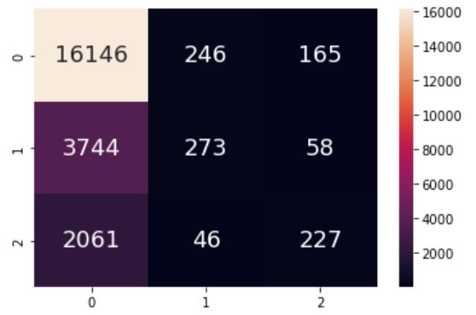
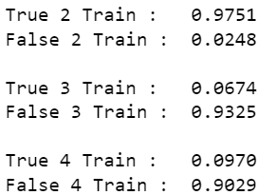
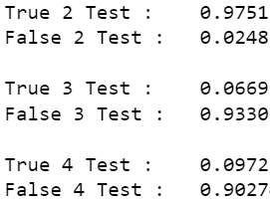
DecisionTreeClassifier (initial data)
Train Data
Test Data
Acc: 0.73
Acc: 0.72

Slide 30
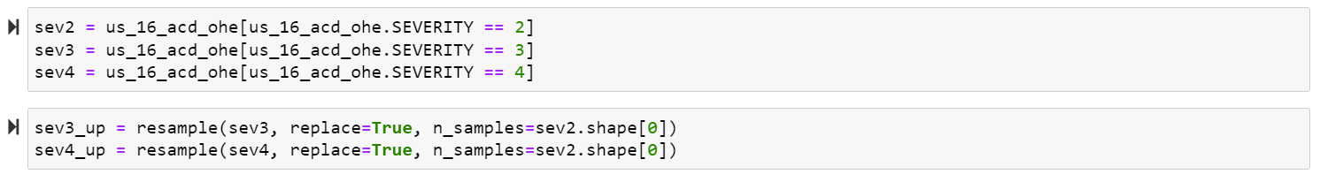
Resample (Imbalanced Data)
The model resamples arrays or sparse matrices in a consistent way. Here, we use it to upsample our sizes of SEVERITY level 3 and 4 to the size of level 2. By applying this step, we solve the issue of the biased data. However, it might affect our prediction accuracy. We will solve the new issue in a later part.
sev2 = us_16_acd_ohe[us_16_acd_ohe.SEVERITY == 2]
sev3 = us_16_acd_ohe[us_16_acd_ohe.SEVERITY == 3]
sev4 = us_16_acd_ohe[us_16_acd_ohe.SEVERITY == 4]
sev3_up = resample(sev3, replace=True, n_samples=sev2.shape[0])
sev4_up = resample(sev4, replace=True, n_samples=sev2.shape[0])

Slide 31
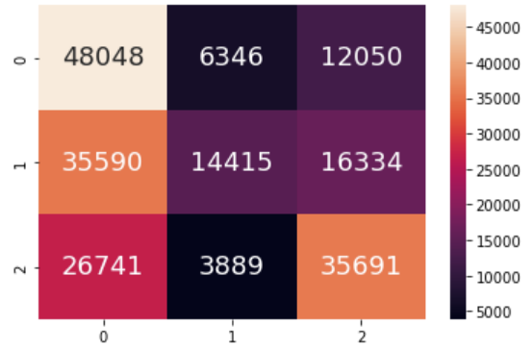
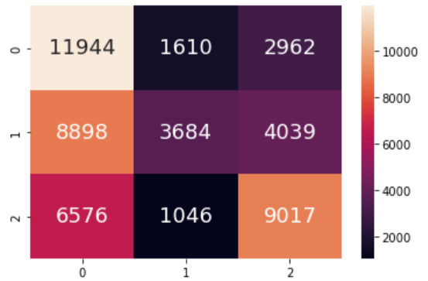
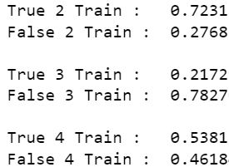
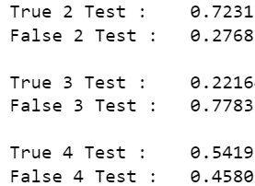
DecisionTreeClassifier (upsampled data)
Train Data
Test Data
Acc: 0.49
Acc: 0.50

Slide 32
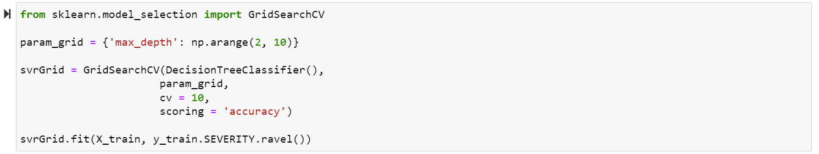
GridSearchCV (cross-validation)
Cross-validation is a statistical method used to estimate the performance (or accuracy) of machine learning models. It is used to protect against overfitting in a predictive model, particularly in a case where the amount of data may be limited. In cross-validation, you make a fixed number of folds (or partitions) of the data, run the analysis on each fold, and then average the overall error estimate.
from sklearn.model_selection import GridSearchCV
param_grid = {'max_depth': np.arange(2, 10)}
svrGrid = GridSearchCV(DecisionTreeClassifier(),
param_grid,
cv = 10,
scoring = 'accuracy')
svrGrid.fit(X_train, y_train.SEVERITY.ravel())

Slide 33
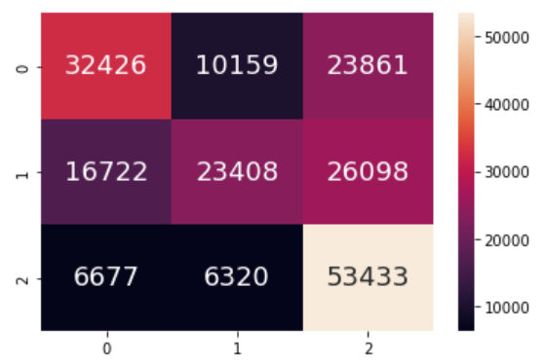
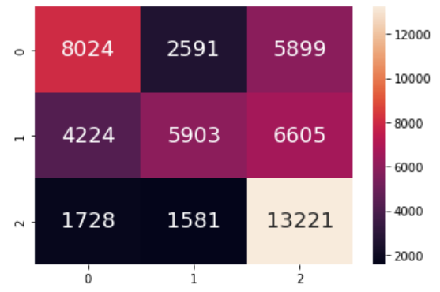
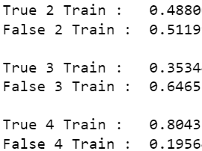
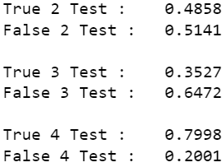
DecisionTreeClassifier (cross-validated)
Train Data
Test Data
Acc: 0.55
Acc: 0.55

Slide 34
RandomForestClassifier
A random forest is a meta estimator that fits a number of decision tree classifiers on various sub-samples of the dataset and uses averaging to improve the predictive accuracy and control over-fitting. You can imagine that we have a tree previously, but now we have a forest, so that we can now return a result which is more accurate.

Slide 35
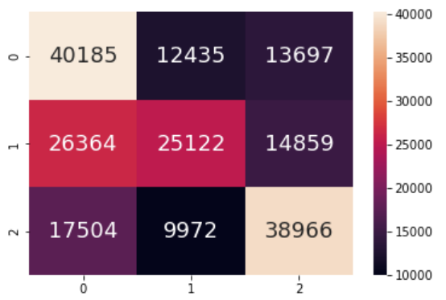
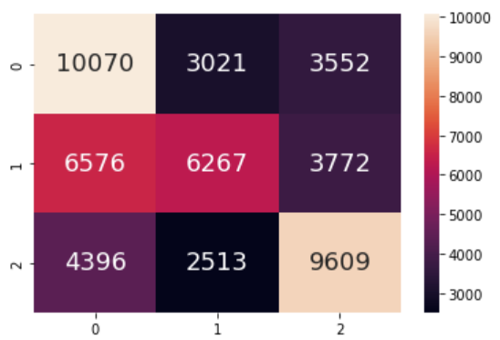
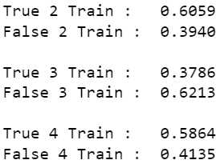
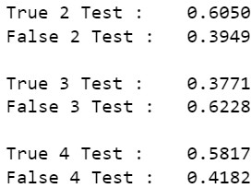
RandomForestClassifier (upsampled data)
Train Data
Test Data
Acc: 0.52
Acc: 0.52

Slide 36
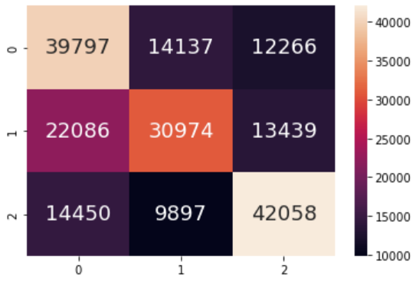
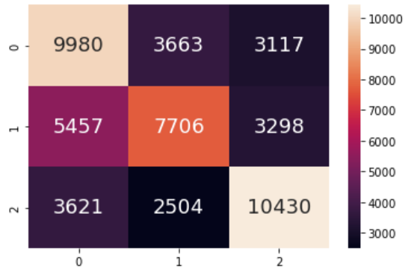


RandomForestClassifier (cross-validated)
Train Data
Test Data
Acc: 0.57
Acc: 0.56

Slide 37

What if we use
Before-upsampled data?
Let’s take a look at imbalanced-learn.

Slide 38
BalancedBaggingClassifier
Bagging (aka bootstrap aggregation) is an ensemble learning method which selects random samples of data in a training set with replacement (can be chosen more than once) and train weak models independently. Ensemble learning aggregates weak learners (single models) to form a strong learner since combination reduces bias and variance.

Slide 39




BalancedBaggingClassifier
Train Data
Test Data
Acc: 0.79
Acc: 0.60

Slide 40
BalancedRandomForestClassifier
Similar to RandomForestClassifier from scikit-learn but applied on imbalanced data. A balanced random forest randomly under-samples each bootstrap sample to balance it.

Slide 41




BalancedRandomForestClassifier
Train Data
Test Data
Acc: 0.73
Acc: 0.56

Slide 42
Upsampled Data vs Imbalanced Data
DecisionTreeClassifier
RandomForestClassifier
BalancedBaggingClassifier
BalancedRandomForestClassifier
55%
57%
Upsampled data
Scikit-learn
Upsampled-data
Scikit-learn
79%
73%
Imbalanced data
Imblearn
Imbalanced data
Imblearn

Slide 43
Logistic Regression
models the probability of a discrete outcome given an input variable

Slide 44




Logistic Regression
Bal Acc: 0.40
Bal Acc: 0.41
Train Data
Test Data

Slide 45

eli 5
feature of relative importance

Slide 46
05
Intelligent Decision
& Outcome

Slide 47

Best Model: Imbalanced-learn BalancedBaggingClassifier BalancedRandomForestClassifier

Slide 48





Peak Hours
Weekdays
Reducing number of cars
California
More traffic signals
Right Side
No Crossing,
No Junction,
No Traffic Signals

Slide 49



What have we learnt?
Scikit-learn
Imblearn
Others
Tableau
Regression
Classification
Utility Models
Visualization
Classification
OLS LinearRegression
LogisticRegression
BalancedBaggingClassifier
BalancedRandomForestClassifier
SimpleImputer
StandardScaler
OneHotEncoder
Resample
GridSearchCV (cross-validation)
ELI5
Tableau Desktop
Tableau Public
DecisionTreeClassifier
RandomForestClassifier

Slide 50
Thanks!

Slide 51
References
Moosavi, S., Mohammad, S., Srinivasan, P., & Rajiv, R. (2019). A Countrywide Traffic Accident Dataset. https://www.kaggle.com/sobhanmoosavi/us-accidents
Moosavi, S., Mohammad, S., Srinivasan, P., Radu, T., & Rajiv, R. (2019). Accident Risk Prediction based on Heterogeneous Sparse Data: New Dataset and Insights. In proceedings of the 27th ACM SIGSPATIAL International Conference on Advances in Geographic Information Systems, ACM, 2019.
Road Safety Facts — Association for Safe International Road Travel. (2022, January 10). Association for Safe International Road Travel. https://www.asirt.org/safe-travel/road-safety-facts/
Pedregosa et al. (2011). Scikit-learn: Machine Learning in Python. JMLR 12, pp. 2825-2830.‌
What is Cross Validation in Machine Learning? Types of Cross Validation. (2020, September 24). GreatLearning Blog: Free Resources What Matters to Shape Your Career! https://www.mygreatlearning.com/blog/cross-validation/
Imbalanced Data | Data Preparation and Feature Engineering for Machine Learning | Google Developers. (2021). Google Developers. https://developers.google.com/machine-learning/data-prep/construct/sampling-splitting/imbalanced-data
Bento, C. (2021, June 28). Decision Tree Classifier explained in real-life: picking a vacation destination. Medium; Towards Data Science. https://towardsdatascience.com/decision-tree-classifier-explained-in-real-life-picking-a-vacation-destination-6226b2b60575
Yadav, D. (2019, December 6). Categorical encoding using Label-Encoding and One-Hot-Encoder. Medium; Towards Data Science. https://towardsdatascience.com/categorical-encoding-using-label-encoding-and-one-hot-encoder-911ef77fb5bd
Lemaître, G., Nogueira, F., & Aridas, C. K. (2017). Imbalanced-learn: A Python Toolbox to Tackle the Curse of Imbalanced Datasets in Machine Learning. Journal of Machine Learning Research, 18(17), 1–5. https://jmlr.org/papers/v18/16-365.html
‌IBM Cloud Education. (2021, May 11). What is Bagging? Ibm.com. https://www.ibm.com/cloud/learn/bagging#:~:text=Bagging%2C%20also%20known%20as%20bootstrap,be%20chosen%20more%20than%20once
python-visualization. (2020). Folium. https://python-visualization.github.io/folium/.
McKinney, W., & others. (2010). Data structures for statistical computing in python. In Proceedings of the 9th Python in Science Conference (Vol. 445, pp. 51–56).

Slide 52







Data Preparation: Rename Variables

Slide 53
Data Preparation: Manipulate Data Type
(all categorical variables)
(from float64)
(TIME)
to_category
to_float32
to_datetime64
377.2 MB
237.5 MB

